Slide 1
Web Engineering Forms Lecture 04

Slide 2
FORMS
Its how HTML does interactivity. There are quite new feature in HTML5. But the fundamental idea does not change since the first web browser.
There basically two ways to use forms in HTML.
Traditionally they are mostly use to interface with the process on server using PHP/ASP.
Today they are often use to interface with JavaScript running on client machine.

Slide 3
Interactive Forms (1)
Without forms, a Web site is “read-only” – it just provides information to the user.
Forms enable the user to provide information to the Web site. For example, the user can:
Perform searches on Web site
Give comments
Ask for info that is not available on the Website
Place order for goods and services

Slide 4
Interactive Forms (2)
Can be simple or very complex
Can fill a whole page or just a single line
Can contain a single element or many
Are always placed between the <BODY> and </BODY> tags of a Web page

Slide 5
Interactive Forms (3)
Are GUI-based
May contain:
Text fields
Check boxes
Buttons
Scrollable lists

Slide 6
FORM Tag
All of the component of a form appear in the content of a <form> tag.
Example:
<form name=“sendEmail” method=“post” action=“sendMailServerScriptURL” autocomplete=“off” > </form>
The action attribute specifies the URL of the application on the web server that is to be called when the user clicks the SUBMIT button.
The method attribute specifies one of the two techniques, get or post. Used to pass the form data to the server.

Slide 7
INPUT Tag
<input> tag is used for text, passwords, checkboxes, radio buttons, action button reset and submit.
One attribute of <input> tag is type, which specifies particular kind of controls
Example
<form name=“sendEmail” method=“get” action=“”>
<input type=“text” name=“name” size=“25” maxlength=“25” />
</form>

Slide 8
Single-Line Text Input Field
<INPUT type=“text”
name=“fieldName”
size=“widthInCharacters”
maxlength=“limitInCharacters”
value=“initialDefaultValue”
placeholder=“initialDefaultValue”
autofocus
required
readonly />

Slide 9
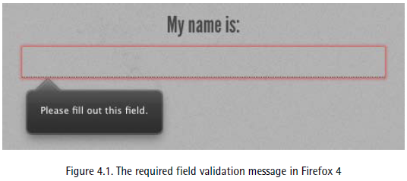
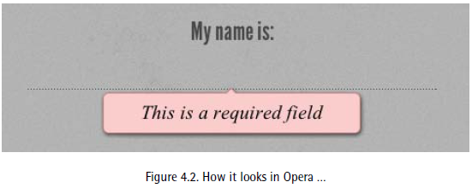
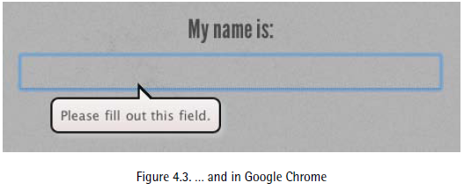

Slide 10
Password Input Field
<INPUT type=“password”
name=“fieldName”
size=“widthInCharacters”
maxlength=“limitInCharacters”
value=“initialDefaultValue”
placeholder=“initialDefaultValue” />

Slide 11
Multi-Line Text Input Area
<TEXTAREA name=“areaName” cols=“widthInCharacters” rows=“numberOfLines”
spellcheck=“true/false” >
</TEXTAREA>

Slide 12
EXAMPLE
<TEXTAREA name=“message” cols=“38” rows=“6”
wrap=“virtual” > </TEXTAREA>
wrap=“virtual” specifies that text in the box will wrap lines as needed

Slide 13
Submit Button Input
<INPUT type=“submit” name=“buttonName” value=“displayedText” />

Slide 14
Reset Button Input Element (Resets the contents of a form to default values)
<INPUT type=“reset”
value=“dispalyedText” >

Slide 15
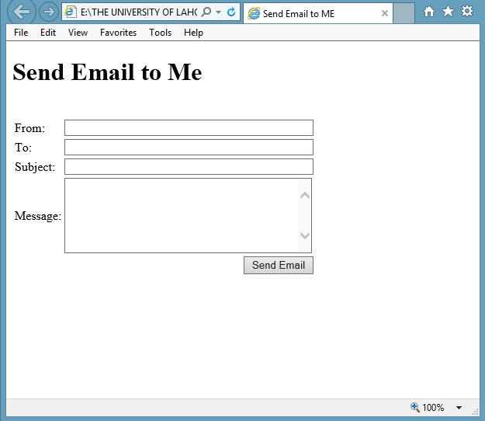

Slide 16
<FORM name="sendEmail" method="post" action=“sendMailScriptURL">
<table><tr>
<td>From: </td>
<td><INPUT type="text" name="sender" size="50“ /></td>
</tr><tr>
<td>To: </td>
<td><INPUT type=“email" name="receiver" size="50“ /></td>
</tr><tr>
<td>Subject: </td>
<td><INPUT type="text" name="subject" size="50“ /></td>
</tr><tr>
<td valign="top">Message: </td>
<td><TEXTAREA name="message" cols="38"rows="6"> </TEXTAREA></td>
</tr><tr>
<td colspan="2" align="right">
<INPUT type="submit" name="sendEmail" value="Send eMail“ />
</td>
</tr></table>
</FORM>

Slide 17
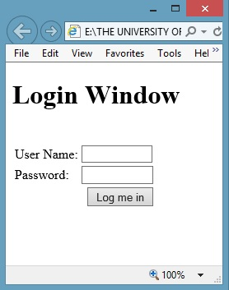

Slide 18
<form name="login" method="post" action="loginScript"> <table><tr> <td>User Name: </td> <td> <input type="text" name="userName" size="10“ /> </td> </tr><tr> <td>Password: </td> <td> <input type="password" name="password" size="10“ /> </td> </tr><tr> <td colspan="2" align="right"> <input type="submit" name="login" value="Log me in“ /> </td> </tr></table> </form>

Slide 19
Checkbox Input Element
<INPUT type=“checkbox”
name=“checkboxName”
checked
value=“checkedValue” />

Slide 20
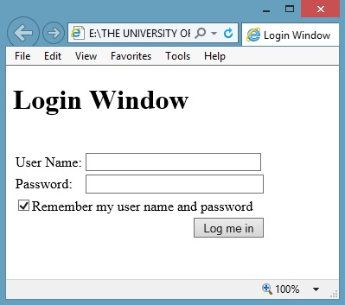

Slide 21
Radio Button Input Element
<INPUT type=“radio”
name=“radioButtonName”
checked
value=“selectedValue” />

Slide 22
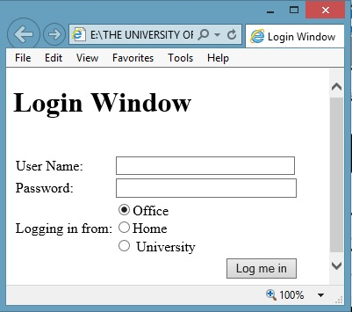

Slide 23
<form name="login" method="post" action="loginScript"> <table><tr> <td>User Name: </td> <td><input type="text" name="userName" size="10"></td> </tr><tr> <td>Password: </td> <td><input type="password" name="password" size="10"></td> </tr><tr> <td valign="top">Logging in from:</td> <td> <input type="radio" name="from" value="home“ checked=“checked”> Home<br> <input type="radio" name="from" value="office"> Home<br> <input type="radio" name="from" value="university" > University </td> </tr><tr> <td colspan="2" align="right"> <input type="submit" name="login" value="Log me in"> </td> </tr></table> </form>

Slide 24
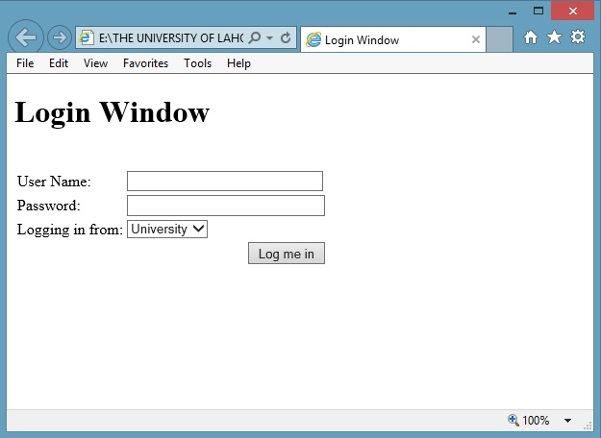

Slide 25
Select from a (Drop Down) List
<SELECT name=“listName”
size=“numberOfDisplayedChoices”
multiple
>
<OPTION value=“value1”> text1
<OPTION value=“value2” selected> text2
<OPTION value=“value3”> text2
…
…
</SELECT>

Slide 26
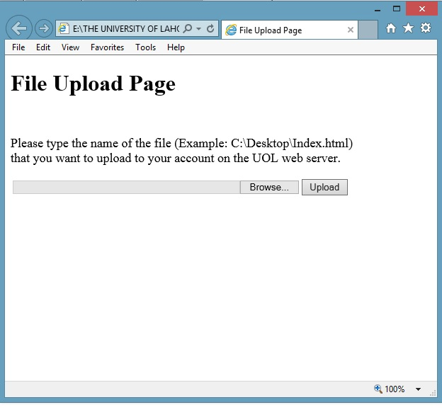

Slide 27
File Upload Input Element
<INPUT type=“file”
name=“uploadfile”
enctype=“multipart/form-data”
size=“35” >

Slide 28
Date Input Element
<INPUT type=“date”
name=“date1”
pattern=“\d{4}-\d{2}-\d{2}”
title=“YYYY-DD-MM” >

Slide 29
Number Input Element
<INPUT type=“number” name=“number1” min=“1”
max=“5”
value=“1” />

Slide 30
Range Input Element
<INPUT type=“range” name=“range1” min=“0”
max=“100”
step=“10”
value=“20” />

Slide 31
Search Input Element
<INPUT type=“search” name=“search1” />

Slide 32
URL Input Element
<INPUT type=“url” name=“url1” />

Slide 33
Color Input Element
<INPUT type=“color” name=“color1”
value=“#336699” />

Slide 34
16 Possible Values for the “type” Attribute of <INPUT> tag
text
password
hidden
checkbox
radio
file
reset
submit
url
email
tel
time
date
search
range
datetime-local

